Slide 1
SCIENCE and ENGINEERING BUSINESS ASSOCIATION

Slide 2
General Body Meeting, 10/19
Introduction
Current Events
Resources at Cornell
Externships
Cover Letters

Slide 3
Current Events

Slide 4
Headlines
Occupy Wall Street
Euro Zone Policy
New Profits Rules

Slide 5
Occupy Wall Street
Occupy Wall Street is leaderless resistance movement with people of many colors, genders and political persuasions. The one thing we all have in common is that We Are The 99% that will no longer tolerate the greed and corruption of the 1%. We are using the revolutionary Arab Spring tactic to achieve our ends and encourage the use of nonviolence to maximize the safety of all participants.

Slide 6
Occupy Goes Global
As of October 15th there were protests in North and South America, Asia, Africa and Europe
Over 1,500 events in 82 countries
Notes:
Complain about problems without providing a solution

Slide 7
Euro Zone
Euro is the official currency of 17 of the 27 European Union members
Benefit from no exchange rate uncertainty, price transparency

Slide 8
Recent Issues
In order to fund infrastructure development countries like Greece, Portugal, Italy and Ireland borrowed money
Now that some of the countries can not pay back the loans

Slide 9
How It Affects Us
People and Corporations in the US have money invested in nations that are now failing
Corporations and people in Europe also invest heavily in the US

Slide 10
New Profits Rules
By changing the accounting definition of profit Citigroup Inc. was able to report a 75% increase, or a total of $1.9 billion
Lots of “paper profits” that do not actually amount to anything

Slide 11
Resources

Slide 12
Cornell Career Services
Offer help with…
www.career.cornell.edu
103 Barnes Hall
Cornell University
Ithaca, NY 14653
career@cornell.edu
Exploring career options
Graduate/Professional school advising
Internships
Full time job searches
Fellowships
Resource for all Career-related information

Slide 13
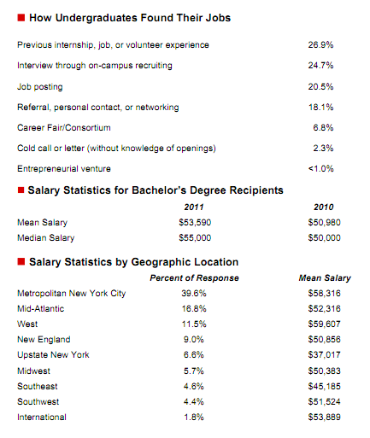
Develop your focus
Career Statistics
Understanding Yourself
Interests, Values, Strengths
Choosing a Major
Exploring your Options
Student Profile in CCNet
Networking
Internships
Info Sessions/Career Fairs
Clubs and Activities
Taking Action
Goal clarification
Applying for Jobs
Checklists

Slide 14
Resume and Cover Letter Help
Cornell Career Guide
Sample Resumes
Chronological resumes
Functional resumes
Combination resumes
Sample Letters
General application
Advertised opening
On campus recruiting
Other useful sample material
Job application letters
Thank you letters
Letters on inquiry
Requesting information interview
Letters to accept/decline a job offer

Slide 15
CornellCareerNet
What is CCNet?
Student Profile
Profile tutorial
On-Campus Recruiting
Online tutorials
Email notices
Programs, job opportunities, career events
cornell-students.experience.com
What you might find
Job postings
Internship postings
Paid/Unpaid
Regional, national, international positions
Full time or short term(fall, winter, spring, or summer)
Work-study
Research
Community service

Slide 16
Externships

Slide 17
What is the Cornell Extern Program?
What has my personal experience been in the Cornell Extern Program?
What can you do to get involved?
http://www.career.cornell.edu/externProgram/default.html

Slide 18
Job shadowing over winter break
Meet with a sponsor (Cornell Alumnus)
Duration ranges anywhere from informational meetings to week long shadowing experiences
http://www.career.cornell.edu/externProgram/default.html

Slide 19
Opportunity to explore your career interests without the stress of an internship or full/part time job
Great way to network and make useful contacts
Easy to learn about a specific company
http://www.career.cornell.edu/externProgram/default.html

Slide 20
Shadowed Jean Hill, CTO of First New York Securities
Met individuals from all departments including trading, front and back office operations, IT, and development
Spent one day at MPS Global, FNY’s broker dealer
http://www.career.cornell.edu/externProgram/default.html

Slide 21
How can you get involved?
Round 2 listings go online today
Round 2 deadline is Monday, October 31
Orientation meetings in mid-November
http://www.career.cornell.edu/externProgram/default.html

Slide 22
Preparing a Cover Letter

Slide 23
Overview
What is a cover letter?
Why do we write a cover letter?
Qualities of a good cover letter
Example
Summary

Slide 24
What is a Cover Letter?
Letter of introduction which accompanies another document such as a résumé or CV
A way for you to introduce yourself to the employer
First impression
A vehicle to convince the employer to read your résumé and invite you for an interview
3 types: application, prospecting, networking
Notes:
So what is a cover letter?
-It’s a letter of introduction which accompanies another document, such as a resume or CV, in a job application
-Essentially, it’s a means by which you can introduce yourself to the employer during the application process
-So really, it’s your first impression, and we all know the clichés about how important first impressions are, but it is true
-The application process is where you try to convince the company that you are the best qualified candidate for the position in question, and that all starts with a first impression
-You need to earn yourself the opportunity to make your case, and the cover letter is where you convince the employer to look at your qualifications and invite you for an interview
-I’d just like to note there are actually 3 main types of cover letters: application, prospecting, and networking; today we will be only focusing on the first, application, as that is most likely the kind you will encounter soon at school

Slide 25
Why Write One?
It may be required
Shows your intention
Shows you have done your homework
Develops a more personal connection with the employer
Distinguishes you as unique from every other candidate
Notes:
-It may be required, especially for internship/co-op positions which provide a little more structure to the candidate selection process
-This your chance to tell the company what position you are applying for; your resume lists your qualifications for the position, but the company must first be aware of what position it is you are interested in
As your first impression with the employer, it’s your chance to give the employer insight into who you are as a person, not just the qualifications you have
You can demonstrate your knowledge of the company and convey that you are genuinely interested in the position, not just submitting a resume to any job you believe you are qualified for
This develops a more personal connection with the employer and allows you to distinguish yourself as unique from all of the other resumes, which ultimately will give the employer reason to invite you for an interview over other candidates

Slide 26
Qualities of a Successful Cover Letter
Clearly states your intentions
Demonstrates interest/enthusiasm for the position
Highlights key info from your resume that is pertinent to the job
Demonstrates knowledge of the company
Remember: you want to compliment your resume, not duplicate it
Notes:
Some qualities of a successful cover letter include:
-clear statement of your intentions; the employer should be able to read the first few sentences and know what position it is that you are applying for
-demonstrate interest/enthusiasm for the position in question; your first impression should not be that this position is just one of many, related to your skills that you are generically applying for; you want to convey that you are genuinely interested in this position as a unique opportunity compared to others
-you want to highlight key info from your resume that is relevant to the specific position; tie your skill set to the job, to show your qualifications, without simply restating your resume
-demonstrate your knowledge of the company; again, show you have done your homework and understand about the company as a whole beyond the narrow scope of the job position you are applying for, such as company culture and mission
-a good rule of thumb to keep in mind is that your cover letter should compliment your resume, not simply duplicate it in letter form

Slide 27
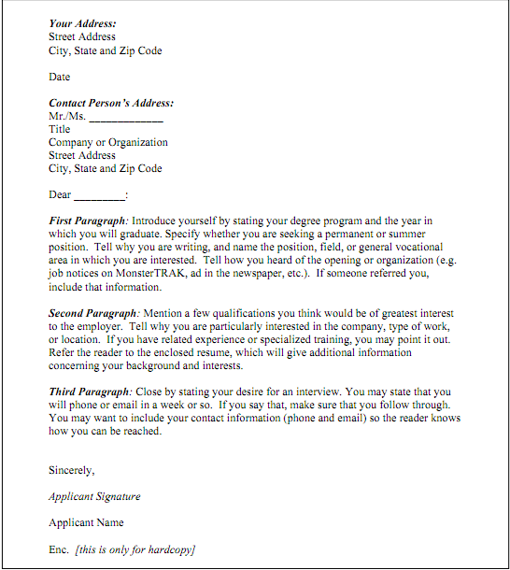
http://www.mit.edu/~career/guide/coverletters.pdf
Notes:
This sample cover letter which I have ripped off of the internet serves as a nice breakdown of a basic cover letter
-note the formatting at the top
-Then to the intro paragraph
-introduce yourself stating who you are (name, school, major)
-state the position you are applying for
-and mention how you learned about the position
-Next paragraph
-begin to highlight the qualifications you think would be of greatest interest to the employer
-talk about related experience or training that relates to the position in question, and refer the employer as necessary to your resume for further details
-DO NOT laundry list your resume
-This formula says here to talk about your interest in the company, I prefer to include this in the third paragraph, as I wrap up with my interest in the position
Closing paragraph
-Wrap up your interest in the position and I like to here tie in the interest in the company
-You can briefly state how the company culture, mission, etc is complimentary to your own desires/needs, bringing a more personal level to the letter and further distinguishing yourself as a unique candidate
-If appropriate, state your intention, ie, if you desire an interview; for internships/co-op assignments, this will most likely be implied by the application
-Sign off

Slide 28
Writing Your Own Cover Letter
Include classes/labs that are relevant
Include any work/internship experience that would be of value to the employer
Mention your career goals and how the company fits into those goals
In general: make sure it is well written, paying attention to detail
Notes:
Since many of you may not have a lot or any experience in internships or project teams related to the positions you are applying for, be sure to highlight your Cornell education
-These companies know you have to start somewhere for experience, so sell your education thus far with pertinent classes and labs
-If you have relevant work experience, be sure to highlight that
-Tie your career goals, if you have an idea of them yet, to the company, to convey why the company is particularly of interest to you
-In general: this is a first impression, make sure it is professional and well-written, paying attention to detail
-It sounds trivial but attention to detail is huge. You may make a cover letter which you then use as a template and modify to the different companies you later apply to. That’s fine, but make sure you update it properly if you don’t start from scratch. I had a friend who wrote a cover letter for motorola in the fall of his junior year and then applied to Shell in the spring of his junior year, didn’t start from scratch on his cover letter, updated the relevant skills and address, but left the into paragraph saying the position at motorola he was interested in…needless to say he did not hear back from Shell
-So make sure the letter is proofread

Slide 29
Summary
A cover letter is an introduction/first impression to an employer
Convinces the employer to read your résumé and invite you for an interview
Clearly states the position of interest
Shows enthusiasm for the position
Demonstrates knowledge of the company
Distinguishes you as unique

Slide 30
Questions?

